Slide 1
12-LEAD ECG ABNORMALITY IDENTIFICATION
USING ML/DL
ScaleMind - Nguyen Phuong Linh, Hoang Minh Thao

Slide 2
HEART RESEARCH
REPORT
ScaleMind - Nguyen Phuong Linh, Hoang Minh Thao

Slide 3
TABLE OF CONTENT
1
2
3
Achievement
&
Difficulties
Paper review
Future work

Slide 4
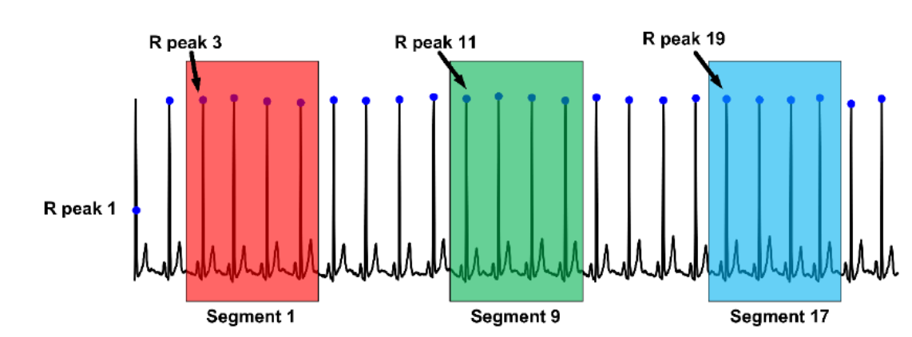
Paper review
Classification of 12-Lead ECG Signals with Bi-directional LSTM Network
Year: 2018
Authors: Ahmed Mostayed, Junye Luo, Xingliang Shu, William Wee
Dataset: CPSC 2018
Methods:
Data preparation:
+ Data segmentation: Extract each record into segments, each 4 cardiac beats
+ Each segment is annotated with right class label <AF, PAC, PVC only label as pathology at segment containing certain cycle>
Data segmentation
automated algorithm based on QRS detection using stationary wavelet transform

Slide 5
Paper review
Classification of 12-Lead ECG Signals with Bi-directional LSTM Network
Year: 2018
Authors: Ahmed Mostayed, Junye Luo, Xingliang Shu, William Wee
Dataset: CPSC 2018
Methods:
Data preparation:
+ Denoise:
.) Remove baseline wander: Butterworth high-pass filter, cut-off frequency 1 Hz
.) Remove high frequency noise: wavelet transform-based shrinkage methods

Slide 6
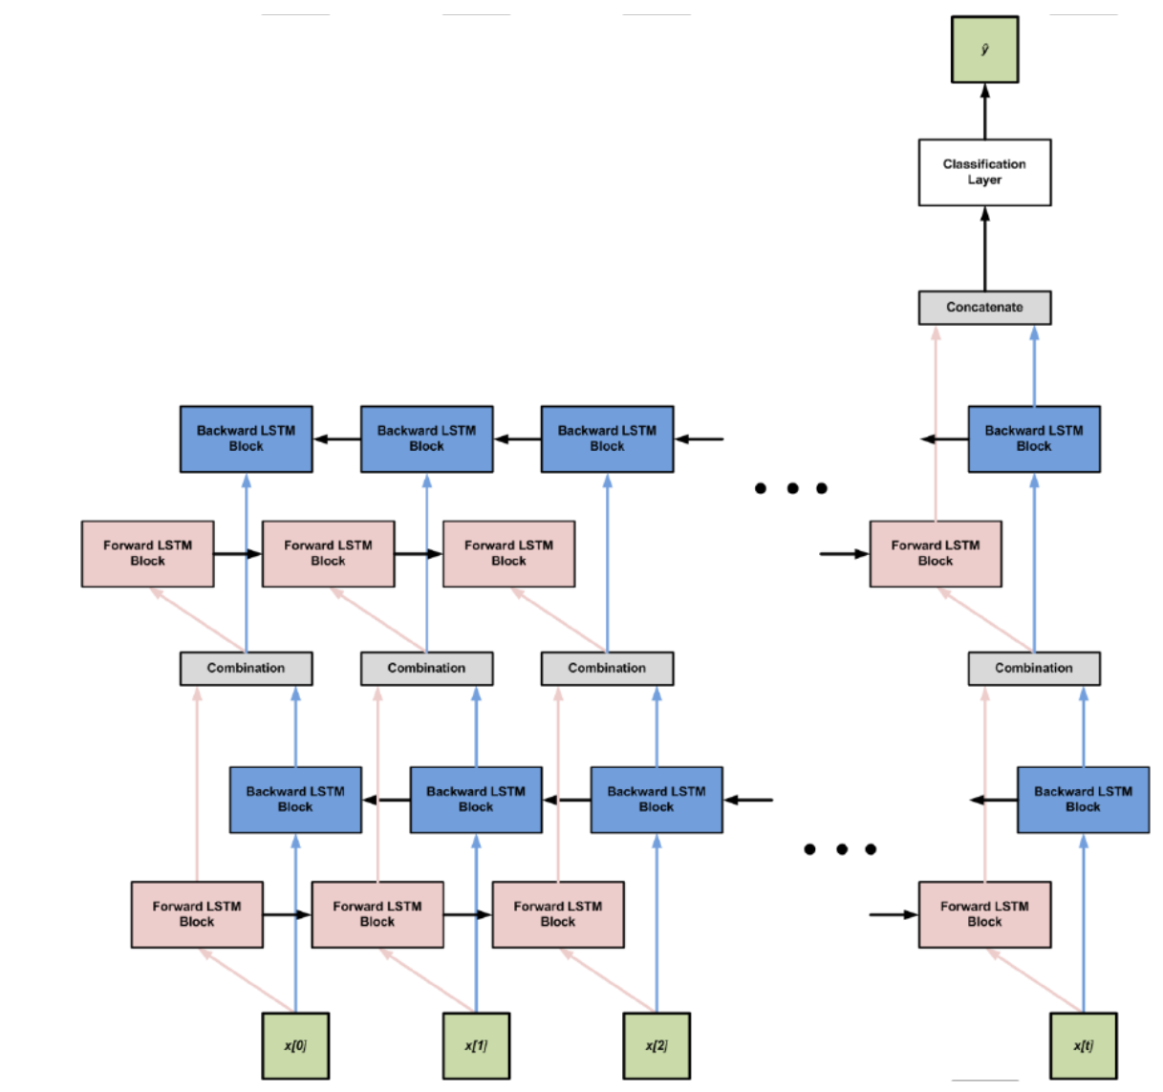
Paper review
Classification of 12-Lead ECG Signals with Bi-directional LSTM Network
Year: 2018
Authors: Ahmed Mostayed, Junye Luo, Xingliang Shu, William Wee
Dataset: CPSC 2018
Methods:
Model:
+ RNN with 2 hidden recurrent layers with 100 recurrent cells each and 1 fully-connected classification (output) layer
+ The recurrent cells are bi-directional LSTM cells.

Slide 7
ACHIEVEMENT
Build a complete flow include sections in a ML project
Training samples (extract 3000 data points) with a simple model and scoring the result

Slide 8
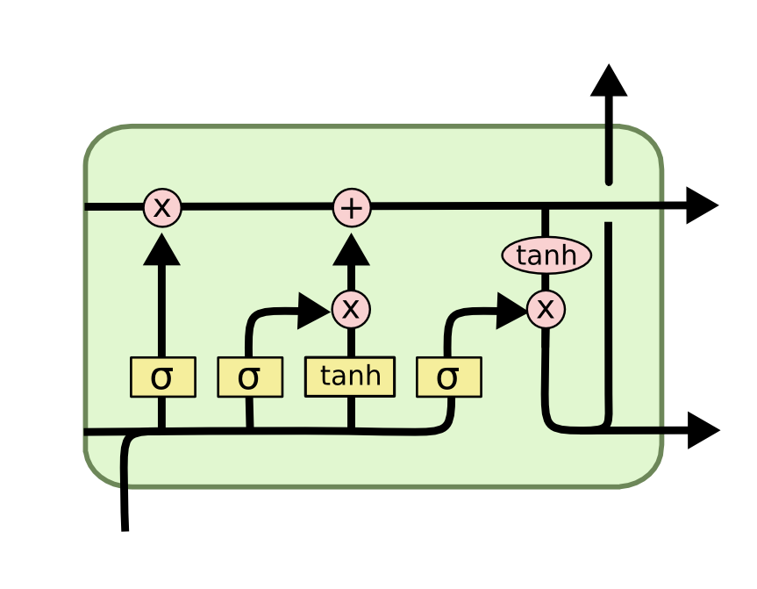
KNOWLEDGE GAIN
LSTM Networks
- Cell state
- Forget gate
- Input gate
- Output gate

Slide 9
DIFFICULTIES
Data samples have different length
Multilabel and labels are for whole recordings
Notes:
Kfold; try: transform data to another domain

Slide 10
FUTURE WORK
Finish flow
Preprocess and denoise data
+ Denoise by different methods
+ Try to segment data

